Slide 1
Suitable New Store Location in London for an Indian Fashion Retailer
-Talha Choudhary

Slide 2
Finding the best location for a Indian Fashion Retailer
The main aim of the study is to identify the best location for a Indian Fashion Retailer to open a store.
The store should be located in a place where Asian population is high
There should be Indian Restaurants, Cafés and Parks
As Asians are very social people that frequent these places often, so opening new stores in these locations is becoming popular.

Slide 3
Data acquisition and cleaning
List of areas of London available at: https://en.wikipedia.org/wiki/List_of_areas_of_London
The latitudes and longitudes of those areas which the done with the help of geopy.geocoders library in python
Population of target audience in all the boroughs of London based on their ethnicity at London Datastore, which is a free and open data-sharing portal where anyone can access data relating to the city. The data is available in XLS and CSV format, which we can download and can use as-is for solving our problem. https://data.london.gov.uk/dataset/ethnic-groups-borough

Slide 4
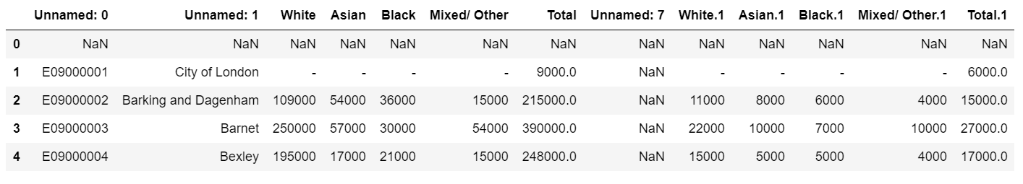
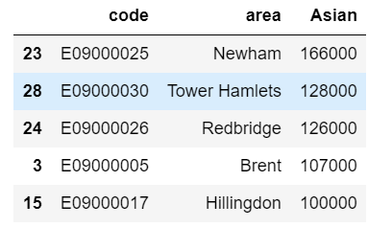
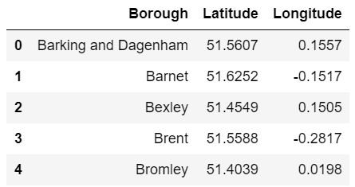
Before and after data cleaning
Before data cleaning
After data cleaning
List of borough in London with latitude and longitude

Slide 5
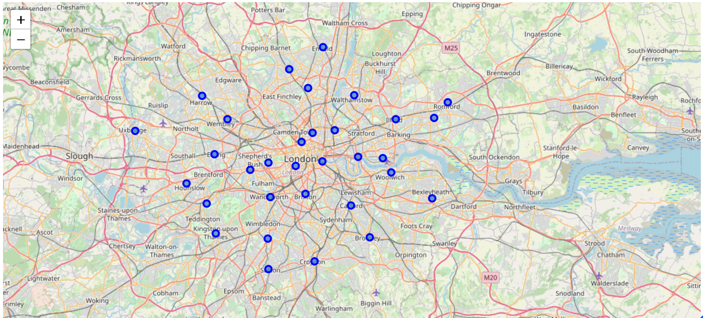
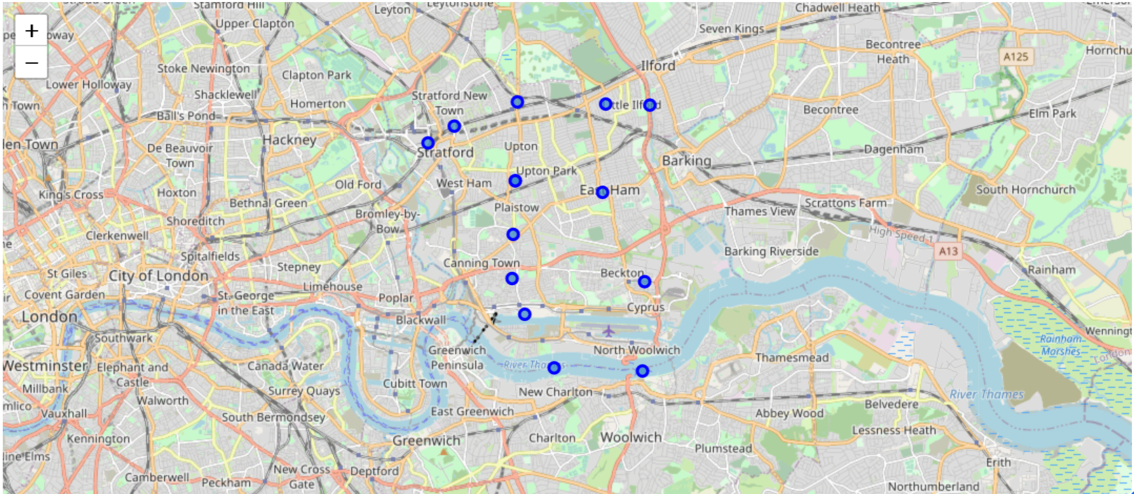
Visualization of all boroughs in London
Visualization of neighbourhood of borough with highest Asian people

Slide 6
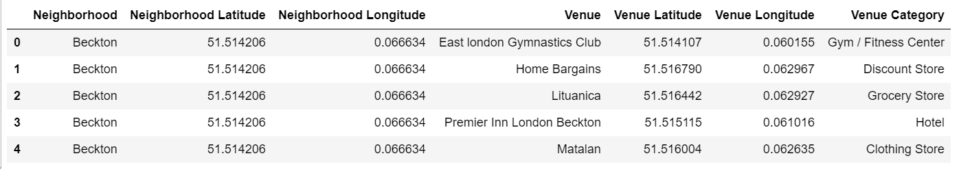
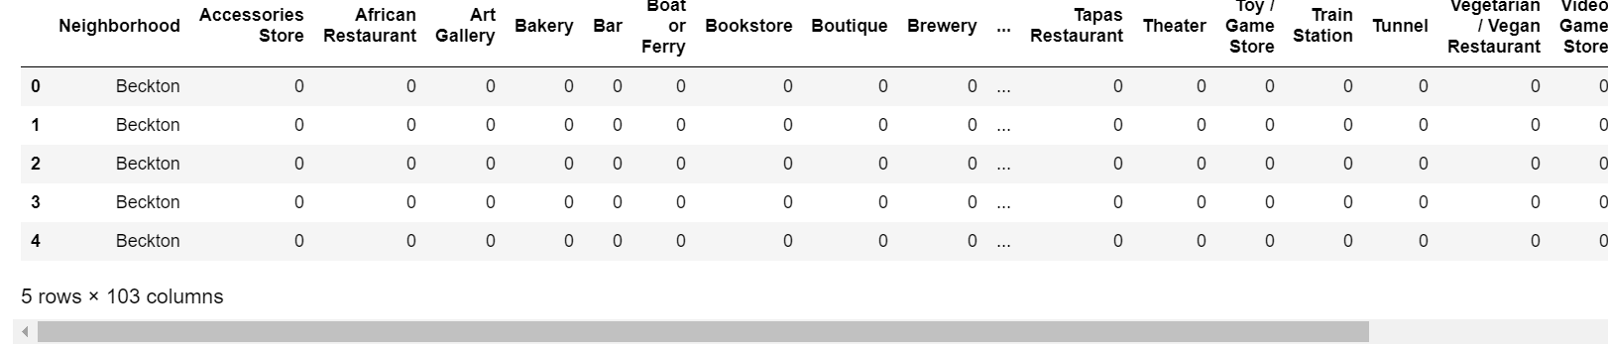
Exploring the neighbourhoods of Newham borough with FourSquare
Displaying how many venues of each category were in each neighborhood

Slide 7
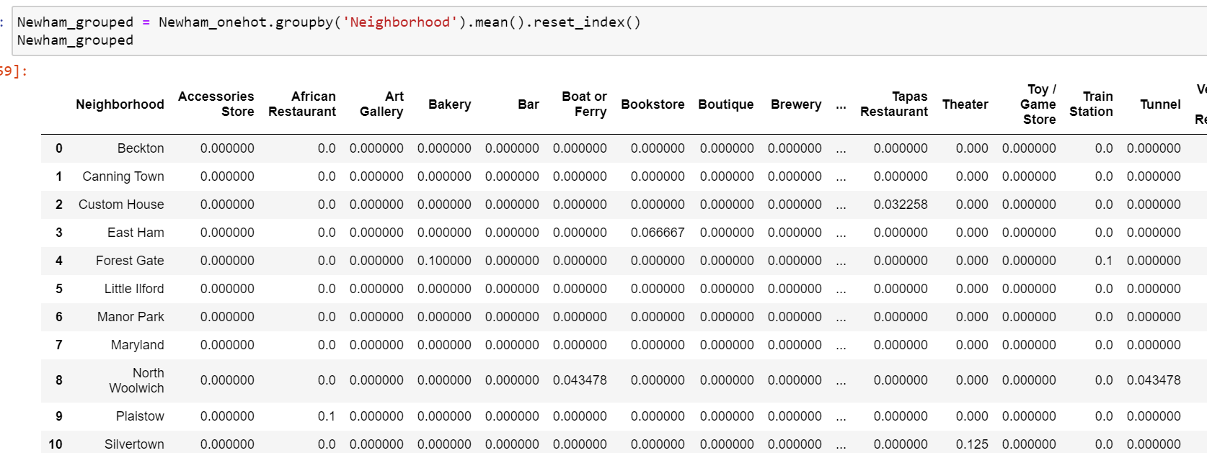
The mean of the frequency of occurrence of each category grouped by neighborhood

Slide 8
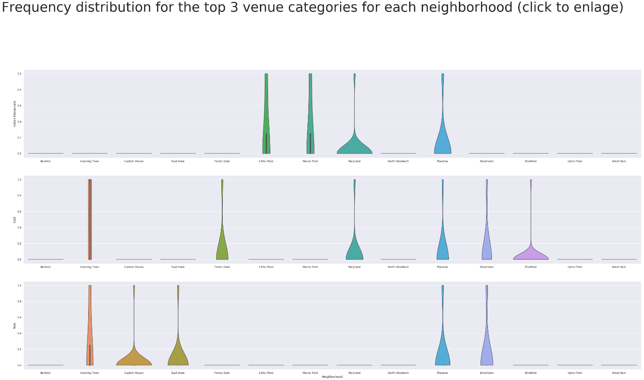
Comparing neighbourhoods by 'Indian Restaurants', 'Cafés' and 'Park'.

Slide 9
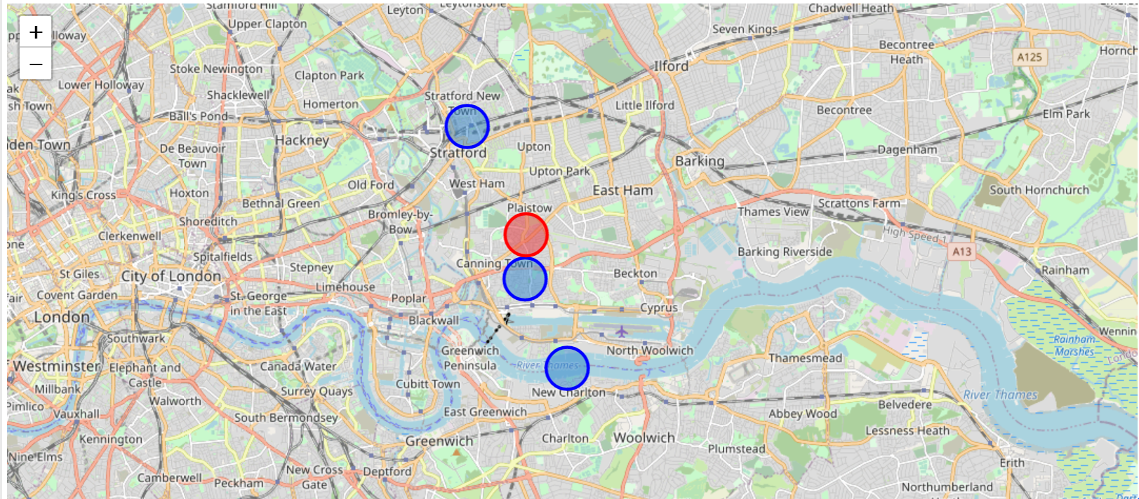
Result
The best neighbourhood to open new stores is Plaistow(marked in Red) as according to the criteria it has the 3 specified venues (Café, Indian restaurant and Parks).
Other Neighbourhoods which satisfy atleast 2 criteria are: Canning Town, Silvertown and Maryland(marked in Blue on the map).

Slide 10
Conclusion and future directions
Built useful models to predict how people will visit the store.
Accuracy of the models has room for improvement.
Capture more of data like
average income of people in each borough
data about the required Business floorspace and Ratelable Value statistics of each borough
Average spending of people based in borough

